Slide 1
Azure Networking

Slide 2
Azure Networking
Virtual Machine Networking
Key Networking Services
Hybrid Connectivity

Slide 3
Azure Networking
Virtual Machine Networking
Key Networking Services
Hybrid Connectivity

Slide 4
Virtual Machine Networking
IPv4 and IPv6 Support
Support for multiple network interfaces for routing and firewalls
Private and/or Public IP addresses (static or dynamic)
Network Security Groups for traffic isolation
Automatic assignment of DNS servers from virtual network or from Azure DNS
Accelerated Networking
MAC Persistence

Slide 5

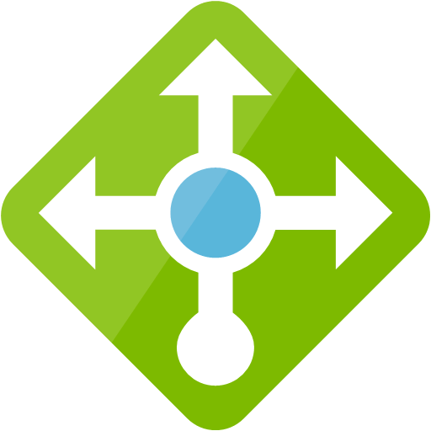

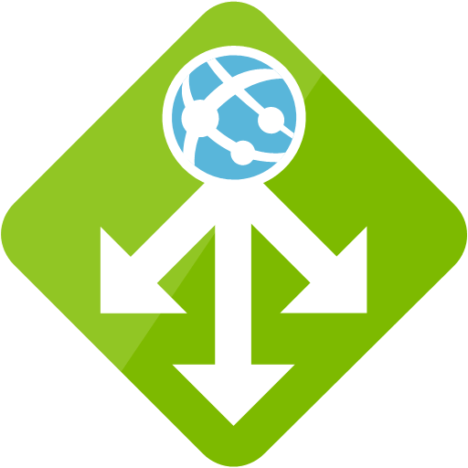
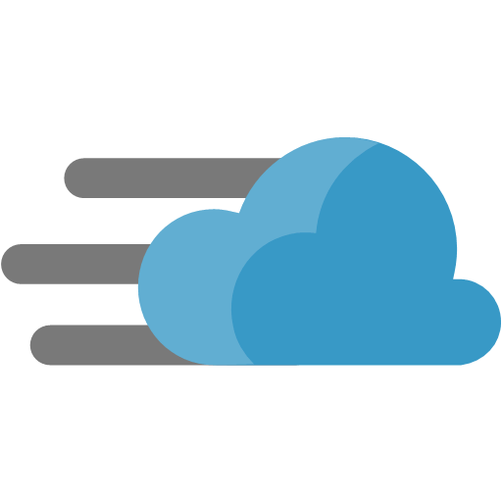

Key Networking Services
Virtual Network
Firewall
Load Balancer
Front Door
Application Gateway with WAF
Content Delivery Network
Traffic Manager
Network Watcher

Slide 6
Azure Virtual Networks
Enables many types of Azure resources, such as Azure Virtual Machines (VM), to securely communicate with each other, the internet, and on-premises networks.
Isolation and segmentation
Each vnet is isolated from other vnets by default.
Communicate with the internet
All resources in a virtual network can communicate outbound to the internet, by default.
Communicate between Azure resources
Through a virtual network.
Through a virtual network service endpoint.

Slide 7
Azure Virtual Networks
Communicate with on-prem resources
Via P2S and S2S VPNs and ExpressRoute
Filter network traffic
Using Network security groups with security rules
Network virtual appliances
Route network traffic
Route tables
BGR routes

Slide 8
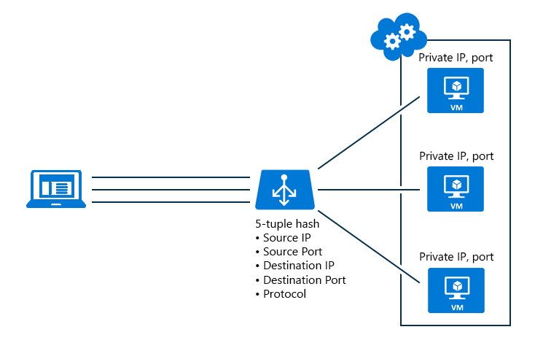
Network Load Balancer
Load Balancer
Scale your applications and create high availability for your services.
Two SKUs, each differing in scenario scale, features, and pricing.
Basic & Standard

Slide 9
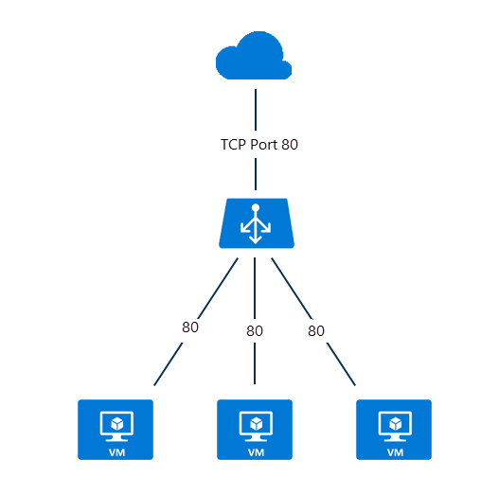
Network Load Balancer - Public
Load Balancer
Maps the public IP address and port number of incoming traffic to the private IP address and port number of the VM, and vice versa for the response traffic from the VM.

Slide 10
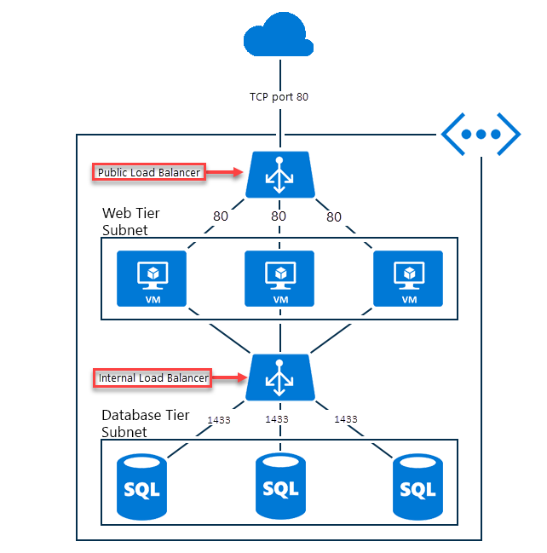
Network Load Balancer - Internal
Load Balancer
Directs traffic only to resources that are inside a virtual network or that use a VPN to access Azure infrastructure.

Slide 11
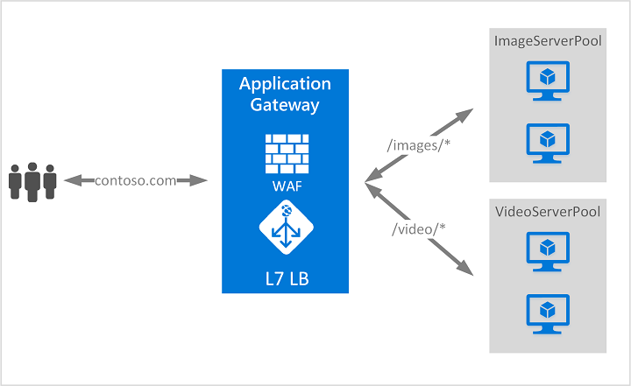
Azure Application Gateway
Application Gateway with WAF
Web traffic load balancer that enables you to manage traffic to your web applications.
Performs application layer (OSI layer 7) load balancing and SSL termination.
Web application firewall based on rules from the OWASP (Open Web Application Security Project) core rule sets 3.0 or 2.2.9.

Slide 12
Traffic Manager
A DNS-based traffic load balancer that enables you to distribute traffic optimally to services across global Azure regions, while providing high availability and responsiveness.
There are several traffic routing methods available in Traffic Manager:
Priority: use a primary service endpoint for all traffic
Weighted: when you want to distribute traffic across a set of endpoints, either evenly or according to weights, which you define.
Performance: when you have endpoints in different geographic locations and you want end users to use the "closest" endpoint in terms of the lowest network latency.
Geographic: users are directed to specific endpoints (Azure, External, or Nested) based on which geographic location their DNS query originates from.
Multivalue: When a query is received for this profile, all healthy endpoints are returned.
Subnet: map sets of end-user IP address ranges to a specific endpoint within a Traffic Manager profile.

Slide 13
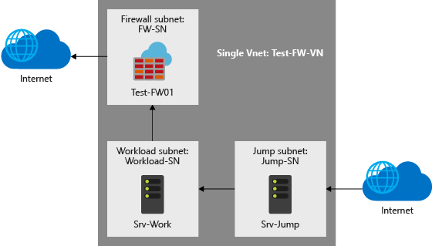
Firewall
A managed, cloud-based network security service that protects your Azure Virtual Network resources.
It is a fully stateful firewall as a service with built-in high availability and unrestricted cloud scalability.
Centrally create, enforce, and log application and network connectivity policies across subscriptions and virtual networks

Slide 14
Front Door
Front Door
Define, manage, and monitor the global routing for your web traffic by optimizing for best performance and instant global failover for high availability.
Works at Layer 7 or HTTP/HTTPS layer and uses anycast protocol with split TCP and Microsoft's global network for improving global connectivity.

Slide 15
Content Delivery Network
Content Delivery Network
A distributed network of servers that can efficiently deliver web content to users.
CDNs store cached content on edge servers in point-of-presence (POP) locations that are close to end users, to minimize latency.

Slide 16
Network Watcher
Network Watcher
Provides tools to monitor, diagnose, view metrics, and enable or disable logs for resources in an Azure virtual network.
Monitor communication between a virtual machine and an endpoint
Diagnose network traffic filtering problems to or from a VM
Diagnose outbound connections from a VM
Capture packets to and from a VM

Slide 17
Azure Networking
Virtual Machine Networking
Key Networking Services
Hybrid Connectivity

Slide 18
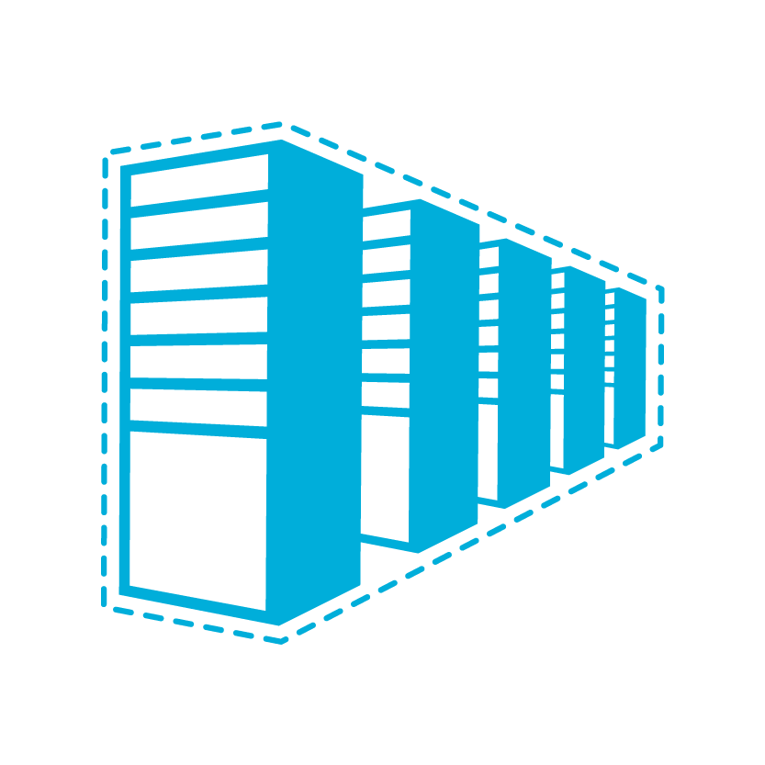


Hybrid Connectivity
Secure point-to-site connectivity
POC Efforts
Small scale deployments
Connect from anywhere
Connect to Azure compute from on-premises or another Azure region
Secure site-to-site
VPN connectivity
In-region VNet-to-VNet connectivity
Direct VM-to-VM connectivity
Peer VNets for routing and transit
VNet Peering
within region
Private connectivity from your on-premises data center to Azure virtual networks and PaaS Services
ExpressRoute private connectivity

Slide 19
ExpressRoute
Fast, private connection to Microsoft cloud services from your on-premises infrastructure or colocation facility.
Layer 3 connectivity between your on-premises network and the Microsoft Cloud through a connectivity provider.
Connectivity can be from an any-to-any (IPVPN) network, a point-to-point Ethernet connection, or through a virtual cross-connection via an Ethernet exchange.

Slide 20
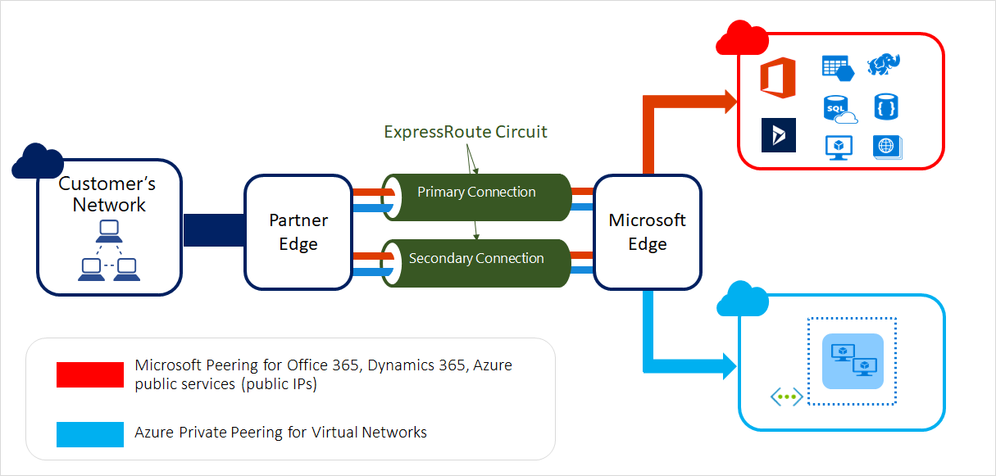
ExpressRoute

Slide 21
Questions?

